Slide 1
Age detection - cnn

Slide 2
AGENDA
Link to datasets
Reading dataset
Visualizing an images
Network Architecture
Working with different partions of the dataset

Slide 3
Link to datasets

Slide 4

UTK Faces Cropped https://www.kaggle.com/datasets/abhikjha/utk-face-cropped
Here you can find the datasets used for this project
Normal Faces https://www.kaggle.com/datasets/mariafrenti/age-prediction

Slide 5
Reading Dataset
We used a dataframe type imported from pandas library to store the image paths with the of each image.
Every face image has it’s age embedded at the beginning of it’s name
Just by reading the path we can divide the dataset into the partions we want to use from it.
First we started the dataset with the whole, then we took the age between 1 – 70, then 1 – 50, then 20 – 50, then a sample of 20 – 50.
Every partion has it’s own model and it’s own evaluations.

Slide 6
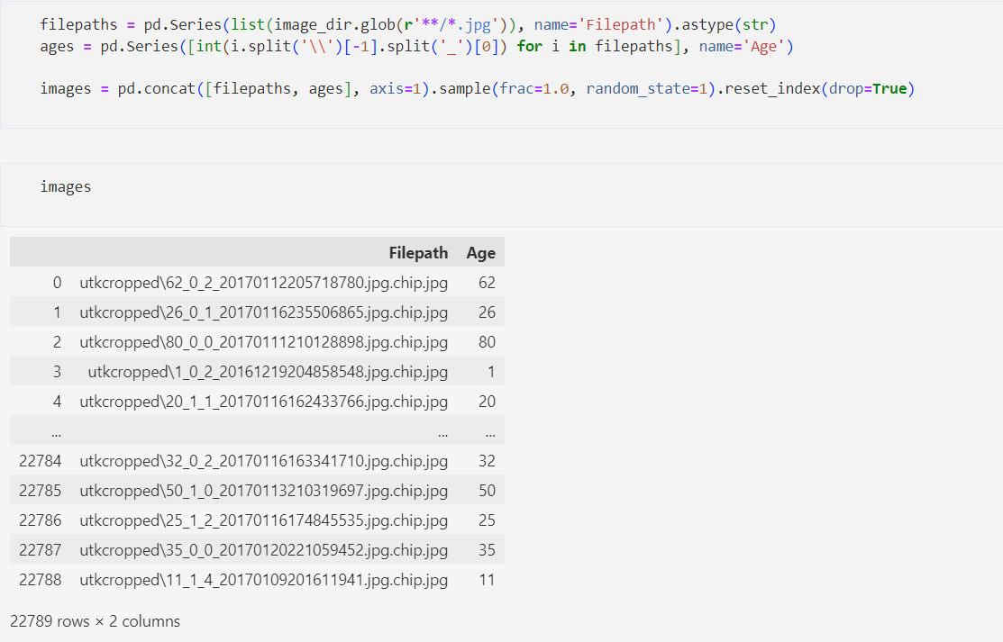
Code snippet

Slide 7
Visualizing Images
Visualizing images is a good way to show the samples of the images you have in the dataset
We used matplotlib library and cv2 for visualizing dataset
Using matplotlib to make a figure and axes
Using cv2 to read the image by it’s path and convert it into matrix so that matplotlib can visualize it

Slide 8
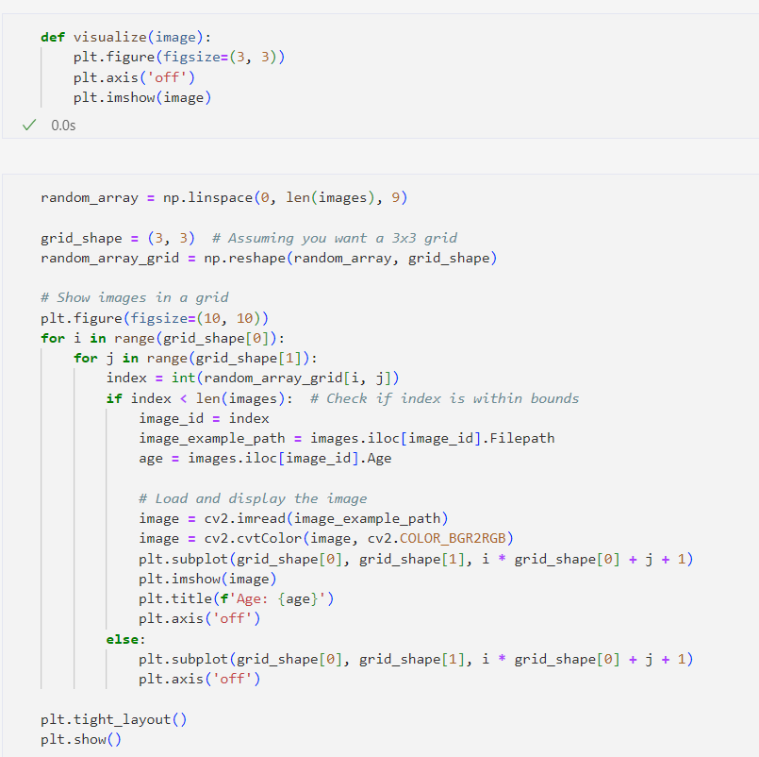
Code snippet

Slide 9
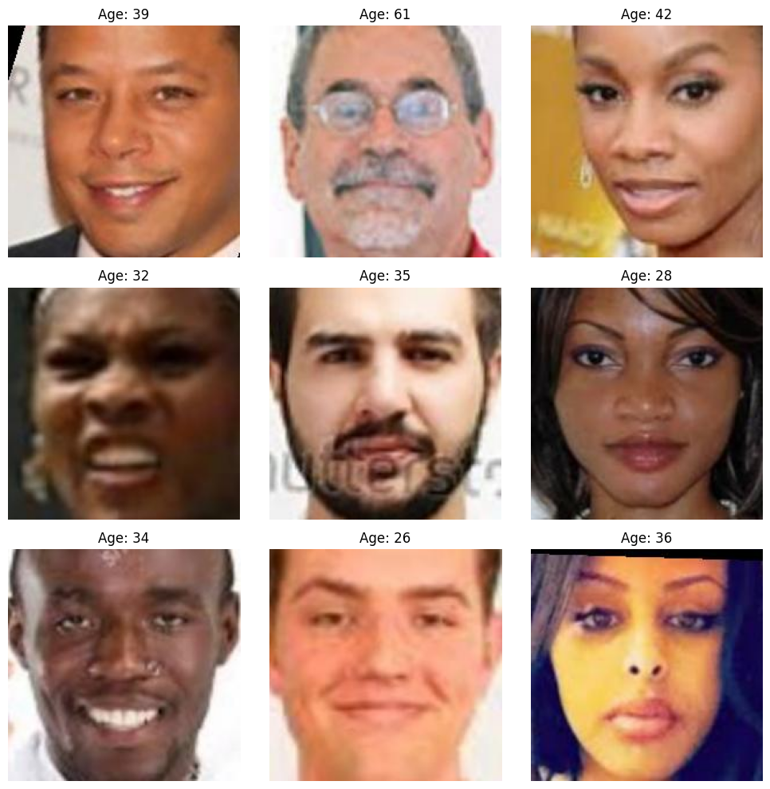
Preview of sample in the dataset

Slide 10
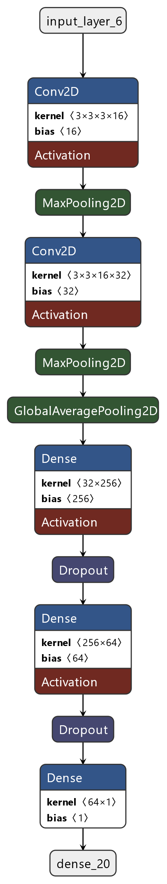
Network Architecture

Slide 11
Network Architecture
The Architecture of the Neural networks relies on the cnn layers
Input layer with shape (200, 200, 3) for colored images
Every CNN layer has a maxpooling layer embedded after it
Two dense (hidden) layers with activation relu and 256, 64 layer respectively and a dropout layer embedded with each
Output layer with activation linear

Slide 12
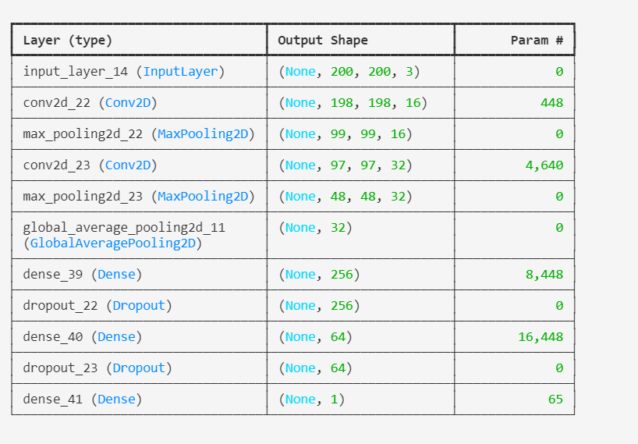
Network Parameters

Slide 13
Working with different Partions of data
Partion | Minimum Loss | RMSE | R² Score
All of the data | 15.1574 | 150 | 0.066601560128
Age between 1 – 70 | 13.0927 | 60 | 0.066601560128
Age between 1 – 50 | 10.1127 | 10 | 0.066601560128
Age between 2 - 50 | 6.9198 | 90 | 0.042665843212
100 sample of every different age (20 - 50) | 8.6315 | 80 | -0.11372345159

Slide 14
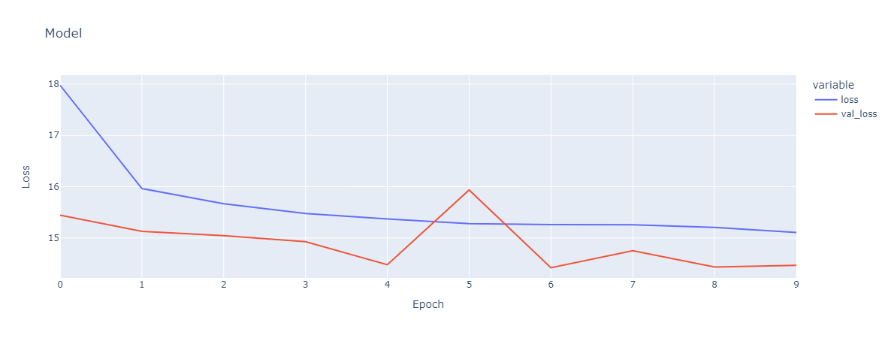
Plot of history of training on first partion

Slide 15
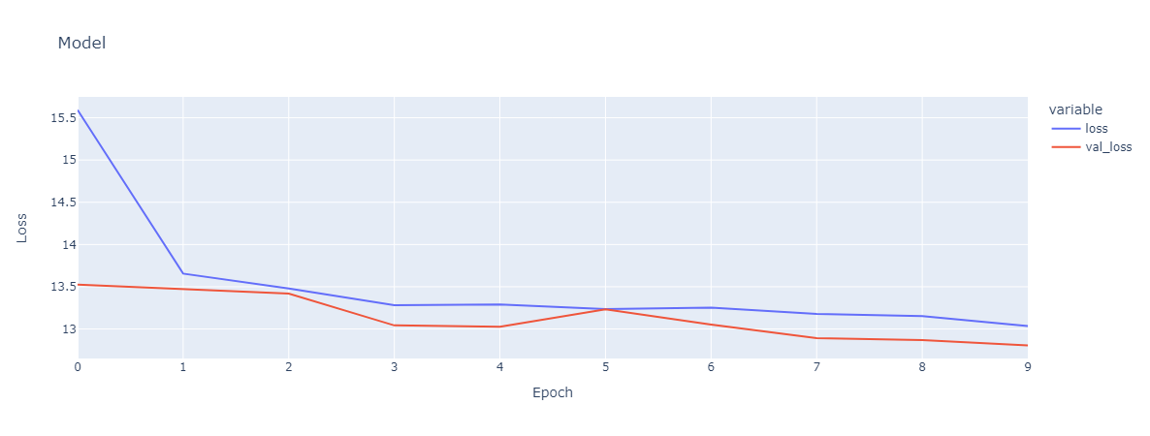
Plot of history of training on Second partion

Slide 16
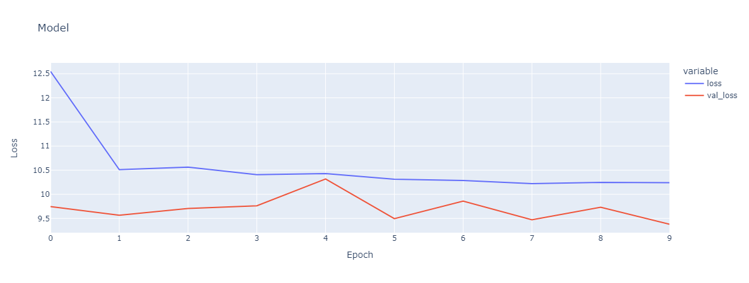
Plot of history of training on Third partion

Slide 17
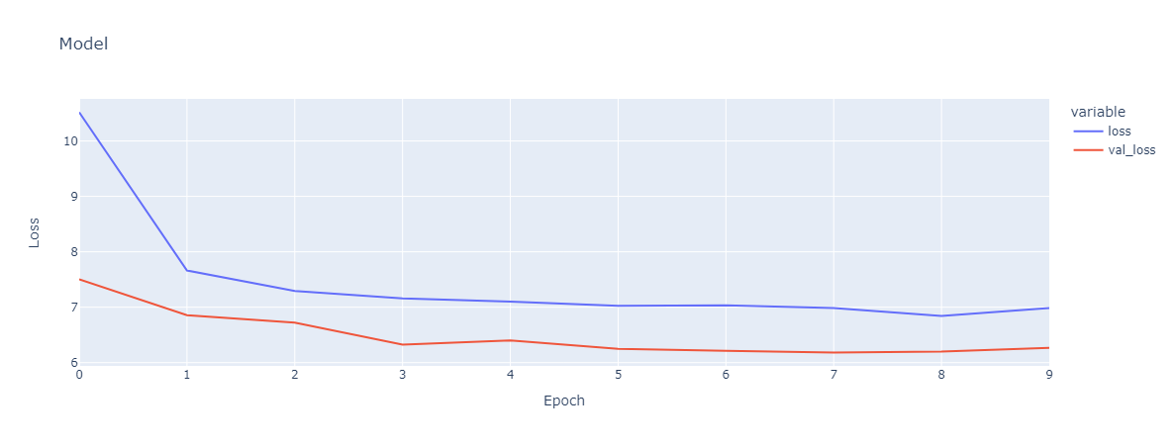
Plot of history of training on fourth partion

Slide 18
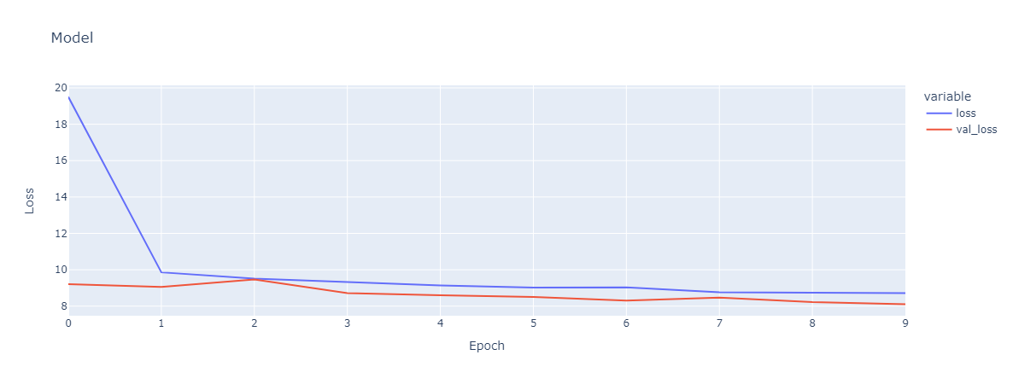
Plot of history of training on fifth partion

Slide 19
THANK YOU

